Slide 1


MEASURE ENERGY CONSUMPTION
NAME:M.Vishnu priya
COURSE NAME: ARTIFICIAL INTELLIGENCE
PROJECT NAME:MEASURE ENERGY CONSUMPTION

Slide 2

01
INTRODUCTION
02
ALGORITHM & FLOW CHART
CONTENTS
03
CODE
04
CONCLUSION

Slide 3
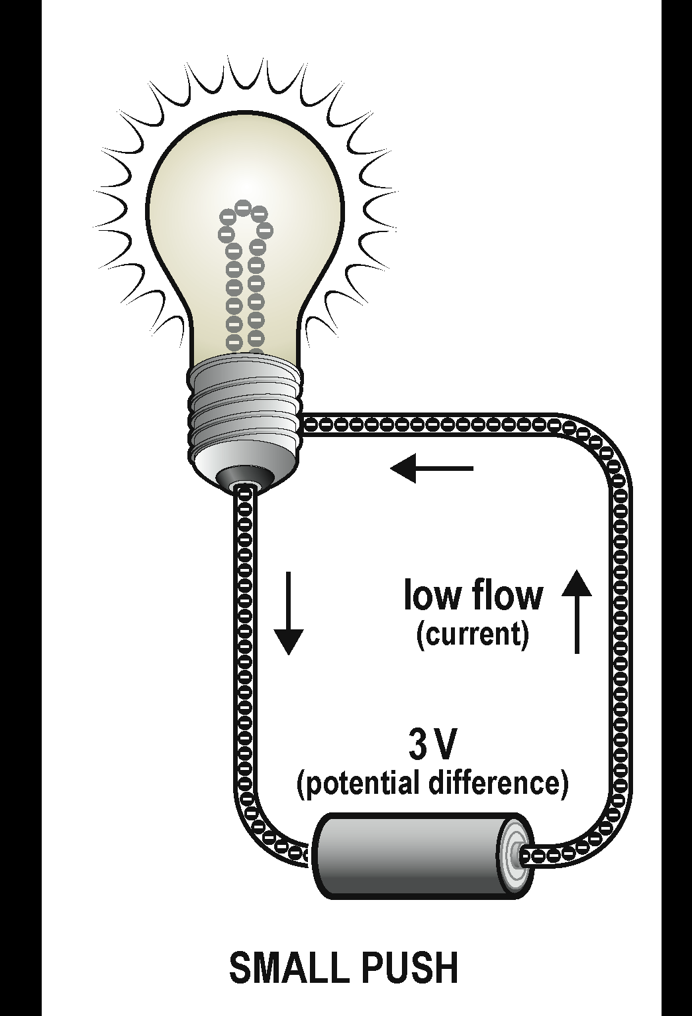
Computer architecture researchers have been investigating energy consumption for decades, especially to be able to deliver state-of-the-art energy efficient processors. Machine learning researchers, on the other hand, have been mainly focused on producing high accurate models without considering energy consumption as an important factor [18]. This is the case for deep learning, where the goal has been to produce deeper and more accurate model without any constraints in terms of computation.Computer architecture researchers have been investigating energy consumption for decades, especially to be able to deliver state-of-the-art energy efficient processors. Machine learning researchers, on the other hand, have been mainly focused on producing high accurate models without considering energy consumption as an important factor [18]. This is the case for deep learning, where the goal has been to produce deeper and more accurate model without any constraints in terms of computation.
01
INTRODUCTION
Computer architecture researchers have been investigating energy consumption for decades, especially to be able to deliver state-of-the-art energy efficient processors. Machine learning researchers, on the other hand, have been mainly focused on producing high accurate models without considering energy consumption as an important factor [18]. This is the case for deep learning, where the goal has been to produce deeper and more accurate model without any constraints in terms of computation.

Slide 4

In order to calculate a household's average consumption, the kilowatts of power consumed by each electronic appliance in the home must be added up. It's also important to take into account the simultaneity factor and calculate the number of electrical appliances that could stay connected to the electrical network at the same time. This information makes it possible to estimate the contracted power your home requires.
Click here to add content of the text，and briefly explain your point of view. Click here to add. content of the text，Click here to add content of the text ，and briefly explain your point of view. Click here to add. content of the text， and briefly explain your point of view.

Slide 5
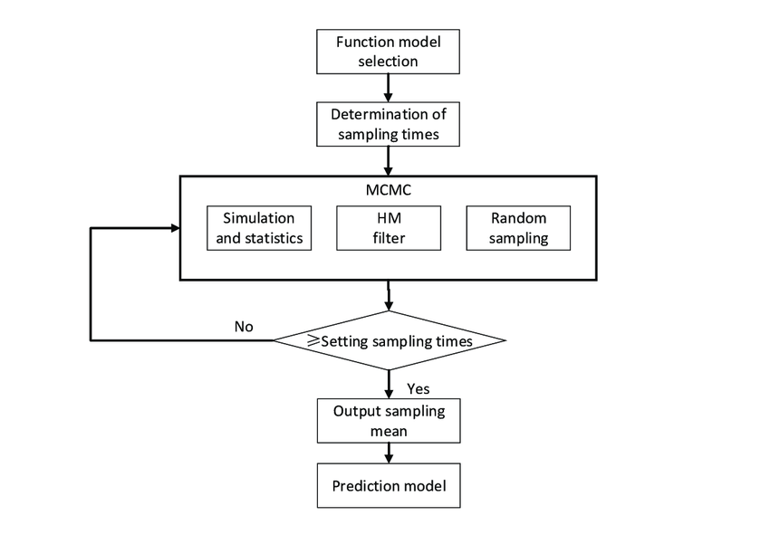
02
ALGORITHM &. FLOW CHART

Slide 6
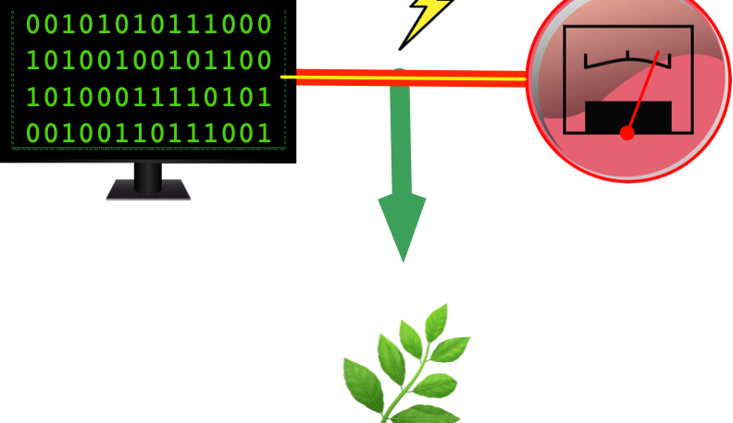

Slide 7
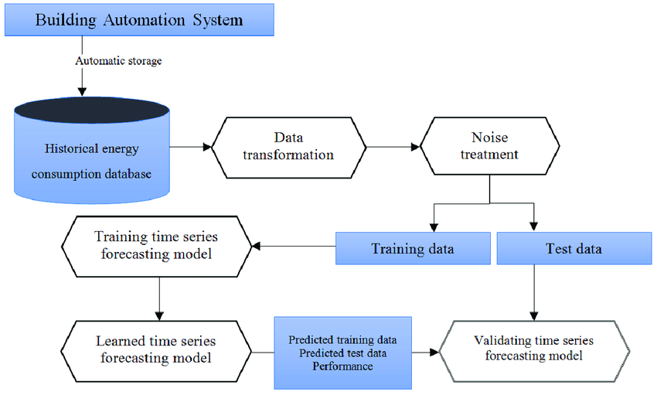

Slide 8
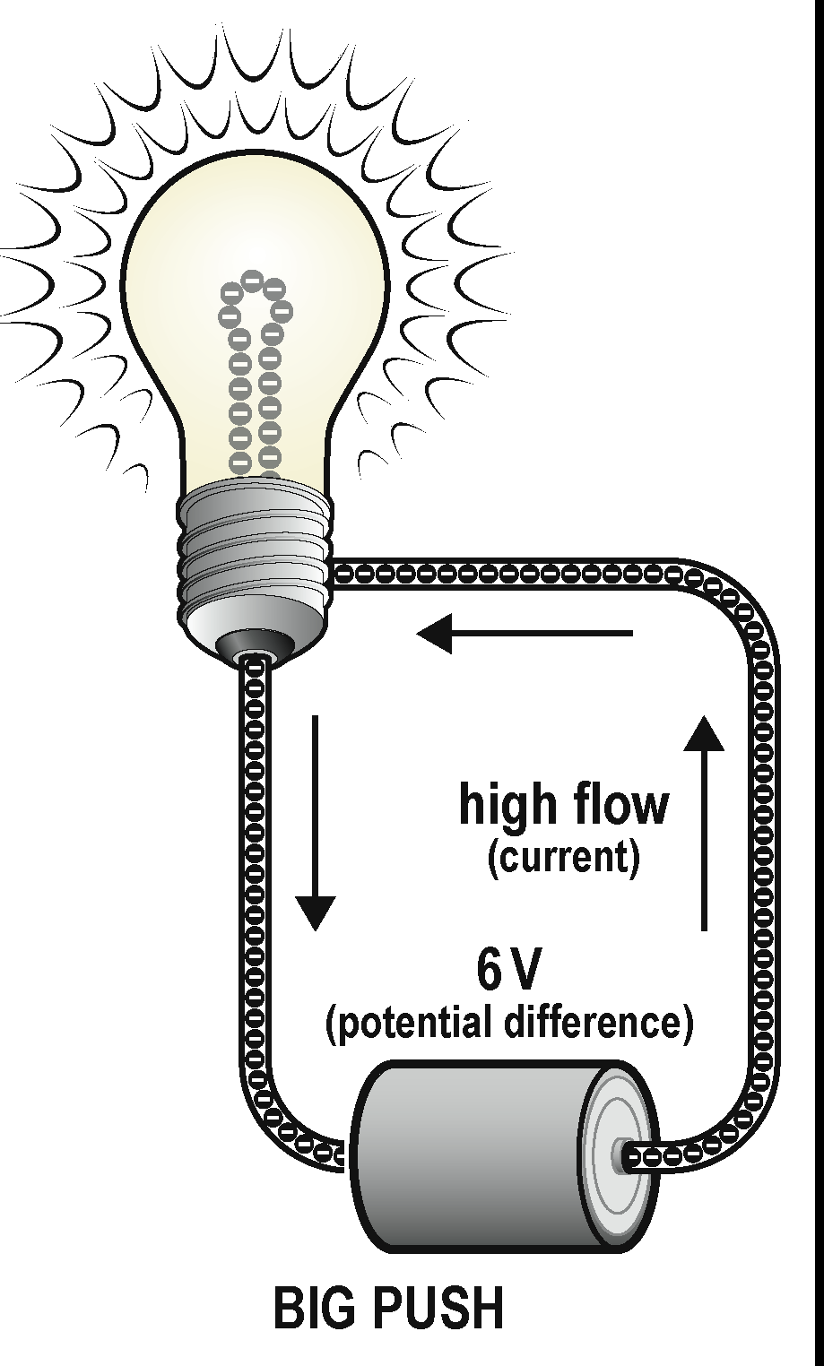
03
CODE
import pyRAPL
pyRAPL.setup()
csv_output = pyRAPL.outputs.CSVOutput('result.csv')
@pyRAPL.measure(output=csv_output)
def foo():
# Instructions to be evaluated.
for _ in range(100):
foo()
csv_output.save()

Slide 9
EARLIER RESEARCH:
The most typical energy efﬁciency indicator in industry is speciﬁc energyconsumption (SEC). It is the ratio between the total energy used and theuseful output of the process measured in physical units, most commonlytons of products (for example GJ/t):SEC ¼energy usedproducts produced (1)The total energy used is the difference between energy inputs andenergy outputs. In industrial processes, the total energy used normallycovers fuel, electricity and steam (Ahtila, Holmberg, Tuomaala, & Turunen,2010, p. 340). Each of these has a different energy value (exergy). All theenergy used should therefore be converted into primary energy, that isenergy before conversion. This is done by taking into account the efﬁcienciesof the conversion processes.

Slide 10
RESEARCH METHOD AND THE CASE STUDY PLANT
The ﬁrm wasappropriate for the study thanks to the energy intensity of its manufacturingprocesses. In addition, it has actively invested in energy efﬁciency. The casesite employs some 850 people. In 2008, it generated revenue ofapproximately 1.2 billion euros. There are 11 operational and support .

Slide 11

04
CONCLUSION
Even if we considered to study the fluctuation of the electricity price for the next years, it turned out impossible to achieve a result. Therefore, it would be interesting to analyse accurate external data such as the weather, the cost price per KWh per energy, the political decisions, etc. Those aspects have a direct influence on the price of energy.
Finally, regarding the Californian state, we were able to model the average power per hour over a year. We see that renewable energies are subject to seasonality. The power of renewable energies is highly volatile, which makes them difficult to predict. For this reason, it is more difficult to predict these data in a very short term.

Slide 12

THANK YOU

